Slide 1
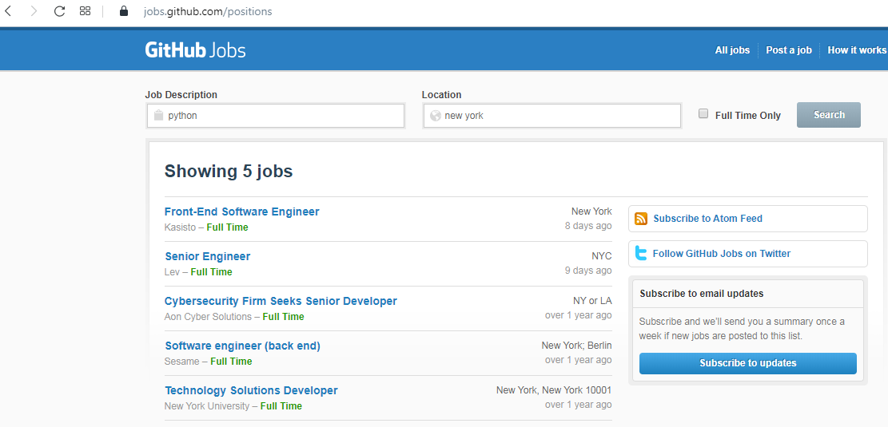

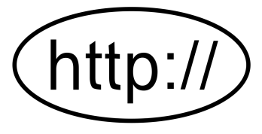
Why do we need HTTP?
Client
Request
Response
Using HTTP Protocol Client send information from client to server.

Slide 2
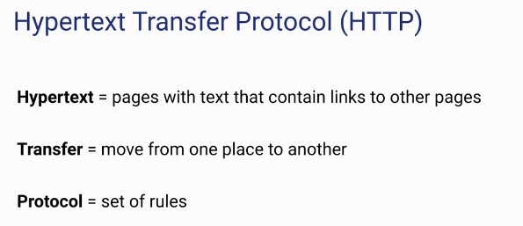
Why do we need HTTP?
The internet cannot work without HTTP
APIs use HTTP

Slide 3
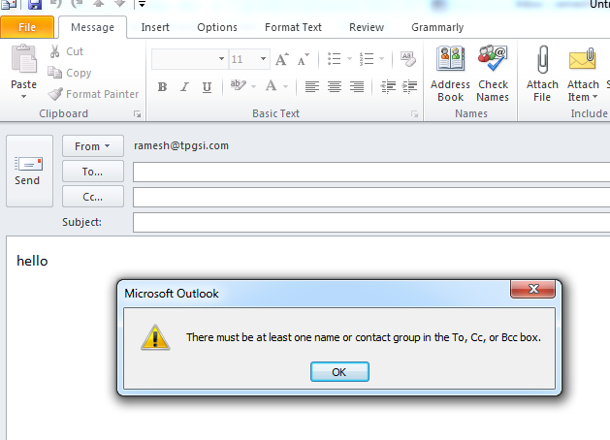
Why do we need HTTP?

Slide 4
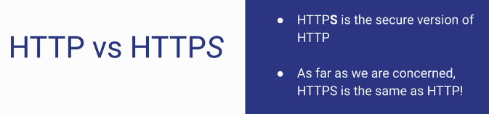
Why do we need HTTP?

Slide 5

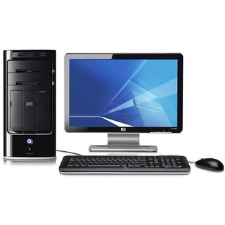



Why do we need HTTP?
Encrypted Message
Server
Client
Encrypted Message
Encrypted Message

Slide 6
Before Spring Boot
https://www.udemy.com/course/introduction-to-apis-rest-api-graphql-soap-web-services-grpc/learn/lecture/18902254#overview

